Slide 1

Scientific english
For energy engineering students
Dezso sera & Lasse Rosendahl
Department of energy technology
Aalborg university
denmark

Slide 2
Course objective and focus
This is Not a traditional english course...
Scientific English (for students having a
bachelor degree from Aalborg University)
Apply different methods for the presentation of scientific
results in the English language as a conference paper, a
poster, a journal paper or orally at conferences
English (for students on the INTRO
semester)
Be able to communicate scientific methods and results
orally and visually in a classroom presentation.
Be able to communicate scientific methods and results
in written form in understandable English
Competences Independently be able communicate results in a proper scientific manner in English
The ABC of scientific communication:
Accurate, Audience-adapted
Brief
Clear
Jakob Stoustrup, Professor,
Dept of Electronic Systems, AAU

Slide 3
Course outline & lecture structure
Lecture 1
Intro
Abstracts
Lecture 2
Scientific papers
Lecture 3
Oral presentations and posters
Lecture 4
workshop

Slide 4
assignments
1 write 200 word abstract to be read and discussed in plenum
2 read and review scientific paper, present review in plenum
3 prepare an oral presentation on project, present in plenum
4 workshop – return to abstract
all assignments will be discussed and commented by your peers ... Peer review!
The assignments must be completed in order to take the exams for the math part of the course

Slide 5
Scientific communication according to the imrad method
Introduction
Why was the study undertaken? What was the research question, the tested hypothesis or the purpose of the research?
Methods
When, where, and how was the study done? What materials were used or who was included in the study groups (patients, etc.)?
Results
What answer was found to the research question; what did the study find? Was the tested hypothesis true?
and
Discussion
What might the answer infer and why does it matter? How does it fit in with what other researchers have found? What are the perspectives for future research?

Slide 6
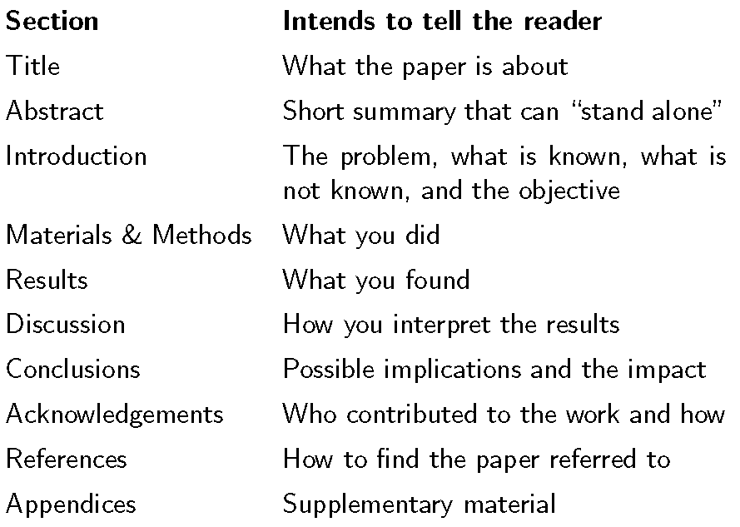
Main sections of a paper
Jakob Stoustrup, Professor,
Dept of Electronic Systems, AAU

Slide 7
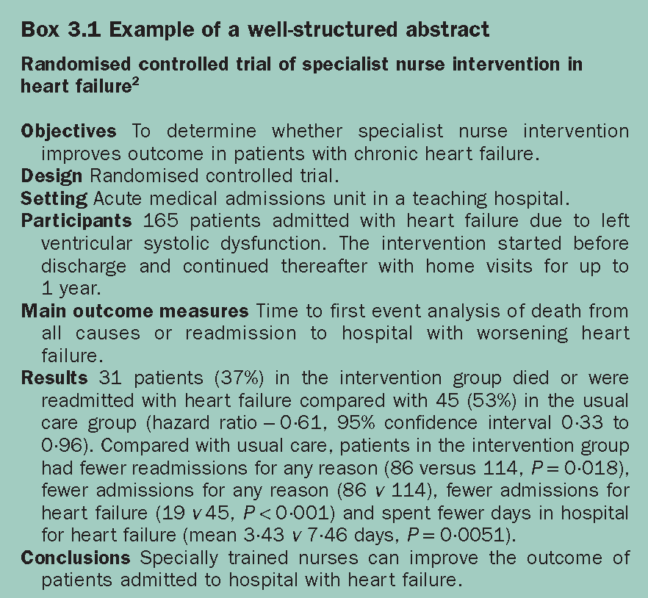
Abstract composition method
Write most important points out in bullets
Count words
Add filling ...
Some journals require structured abstracts →
J. Peat et al (2002). Scientific writing – easy when you know how. BMJ Books, ISBN 0 7279 1625 4

Slide 8
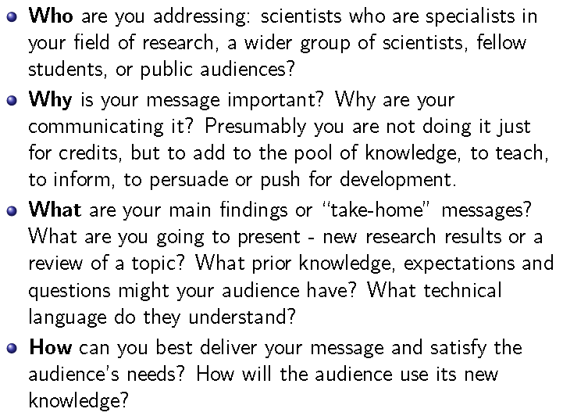
Composing scientific communication – the four w’s

Slide 9
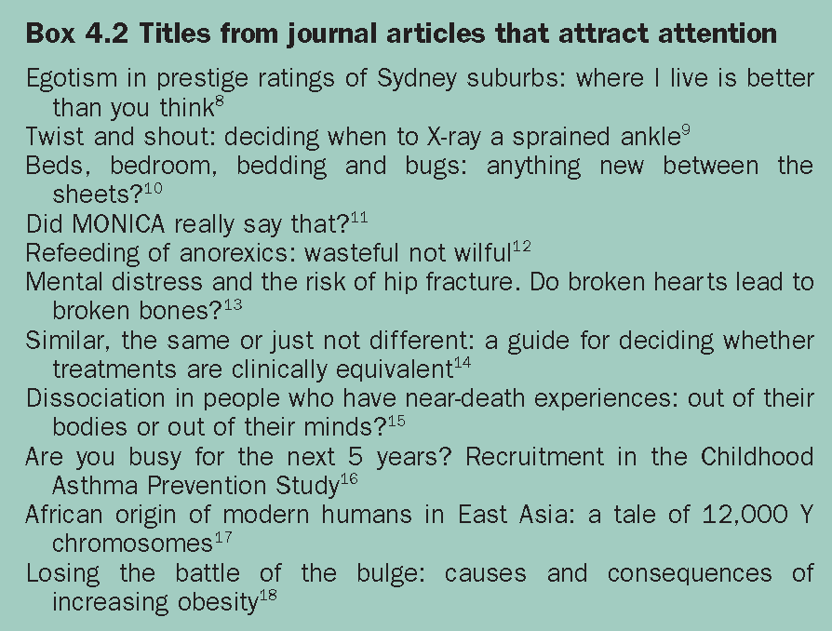
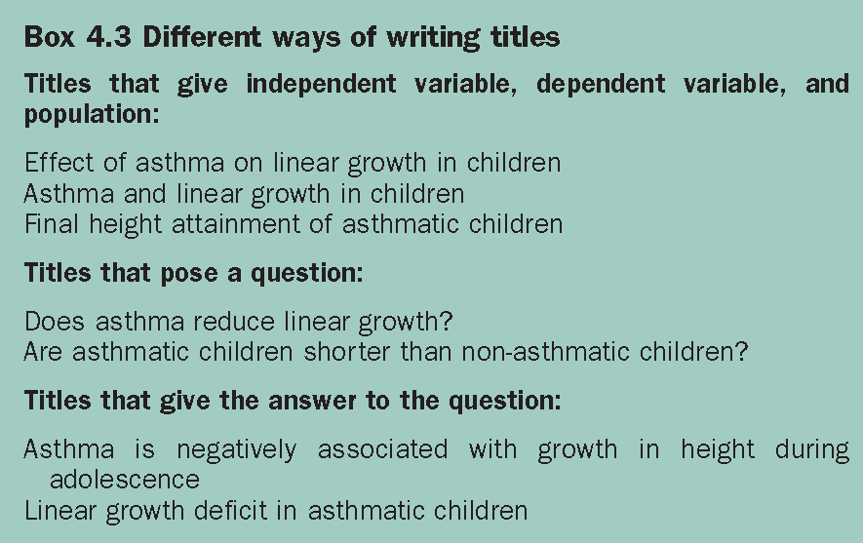
So what about the title ...?

X
J. Peat et al (2002). Scientific writing – easy when you know how. BMJ Books, ISBN 0 7279 1625 4

Slide 10
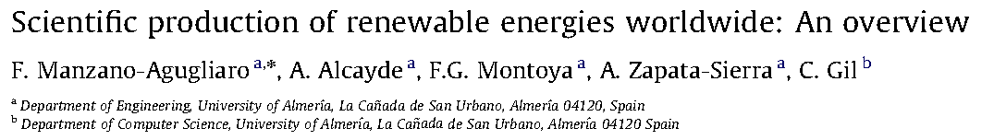
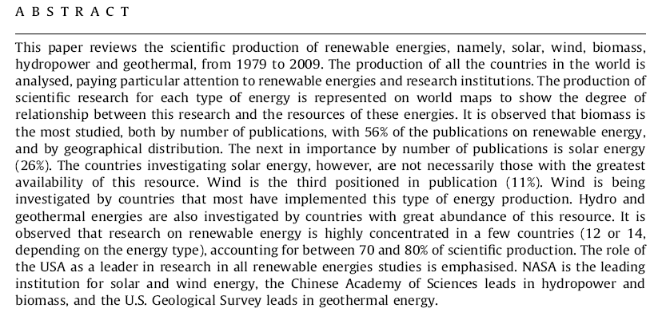
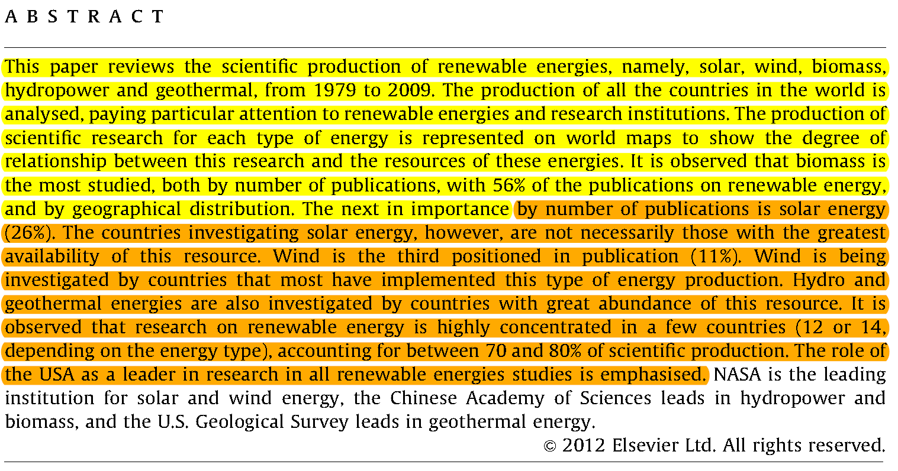
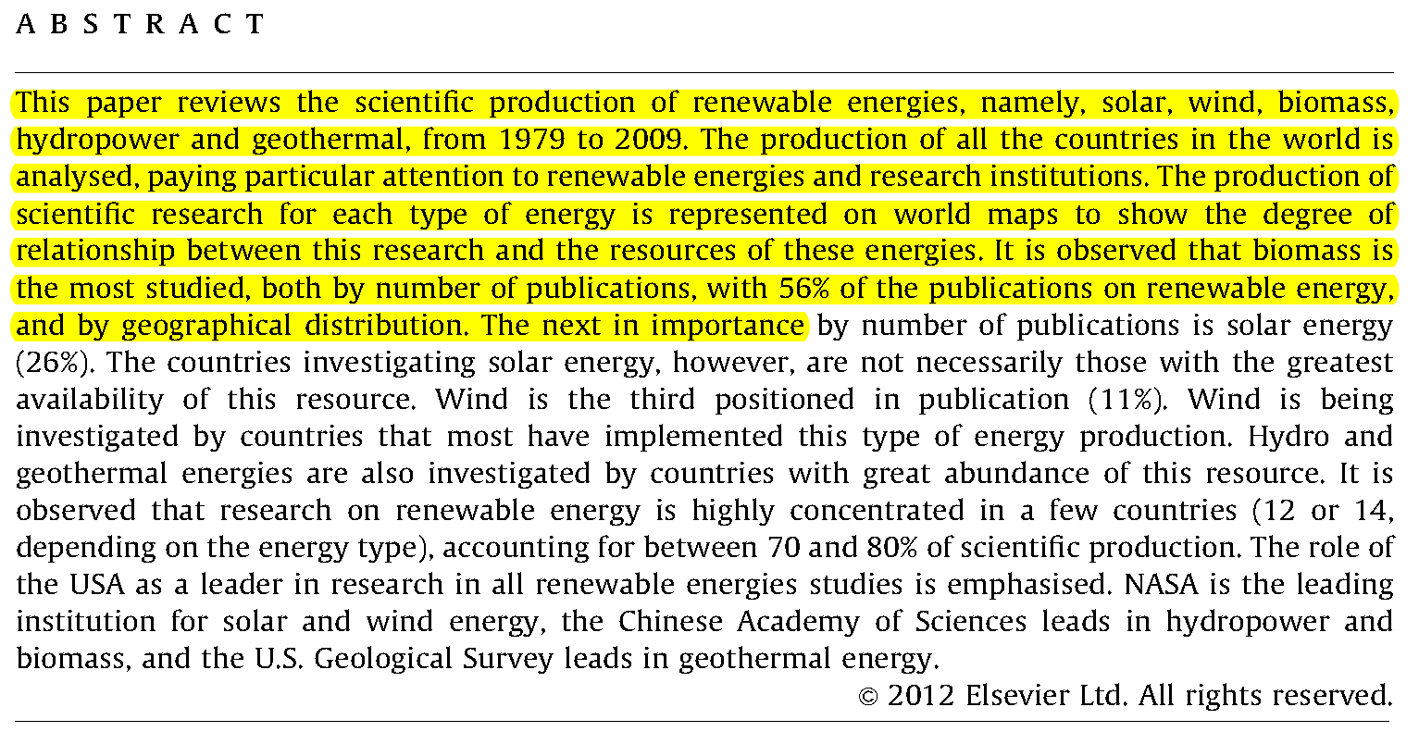
Abstract lengths – 100 and 200 words is not a lot ...
Title?
100
200

Slide 11
Abstract lengths – 100 and 200 words is not a lot ...
Identify the four w’s ...

Slide 12
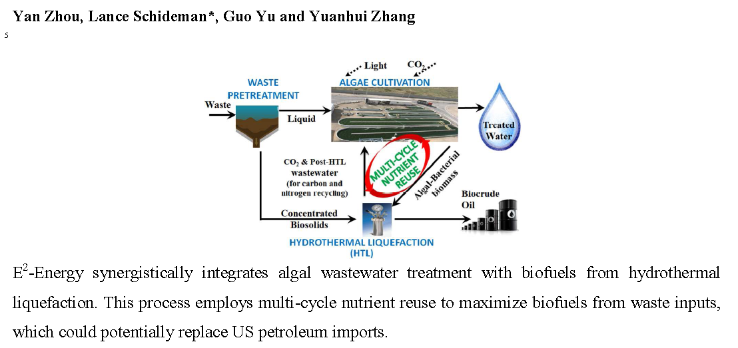
The graphical abstract – a special case

Slide 13
Extended abstracts – common for conferences
Longer than normal abstracts, typically 1 or 1 1/2 pages
Form relatively free
Graphics can be included
example

Slide 14
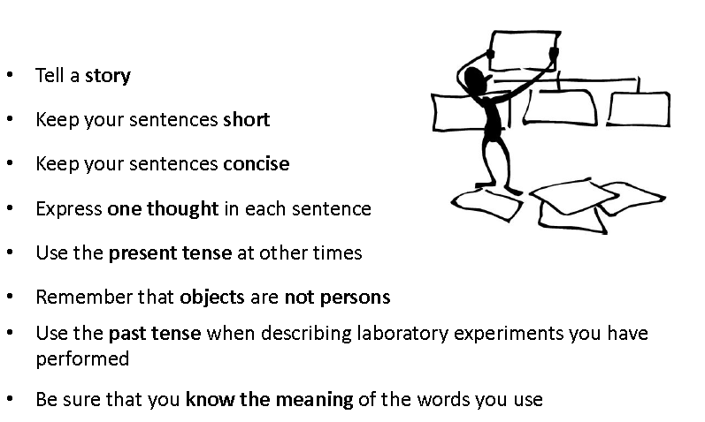
Basic guidelines for writing

Slide 15

ASSIGNMENT 1a – WRITING YOUR FIRST ABSTRACT
IN YOUR GROUPS, WRITE A 200 WORD ABSTRACT ON YOUR PROJECT TOPIC WITH THE FOLLOWING GUIDES:
TITLE (max 1 line)
AUTHORS & AFFILIATION
KEYWORDS (5)
ABSTRACT (200 words)
IF YOU DON’T HAVE A TOPIC YET, WRITE ON WHAT
YOU THINK WILL BE THE TOPIC.
If you have no idea, use your imagination...
Once you’re done, e-mail it in a word doc to either
des@et.aau.dk if you are intro semester
lar@et.aau.dk if you are not
Using the naming format: sciwri_”yourgroup””yoursemester”1.docx
For this task: 1 hour - for help skype lasserosendahl

Slide 16
Assignment 1b – peer reviewing an abstract
Read the abstract
Find the four w’s
Identify 2 good things in the abstract
Identify 2 things in the abstract which could be improved
Provide feedback to your peers in a way that you yourself would like to recieve it
For each abstract we have 10 mins

Slide 17
Assignment 2 – reviewing and analysing a paper
Read the paper in moodle and prepare a 5 min presentation including the following:
a short review
Identification of the four w’s
Identification of 5 good aspects of the paper
Identification of 5 not so good points
Name the presentation Sciwri2_”yourname””yoursemester”
And e-mail it as for assignment 1
This is an individual assignment.
In lecture 2 you will present your review and there will be peer review for each presentation.

